Slide 1
Action Recognition in Video Sequences using Deep Bi-Directional LSTM With CNN Features
Action Recognition in Video Sequences using Deep Bi-Directional LSTM With CNN Features
Afna salam
04, S7R
Dept. of CSE, MACE
29 September 2018

Slide 2
Contents
Action Recognition in Video Sequences using Deep Bi-Directional LSTM With CNN Features
Introduction
Related works
Proposed method
Feature Extraction
CNN
AlexNet

Slide 3
Contents(contd.)
Action Recognition in Video Sequences using Deep Bi-Directional LSTM With CNN Features
Sequential Learning
LSTM
Multilayer LSTM
Deep Bidirectional LSTM
Experimental evaluation
Conclusion
References

Slide 4
Introduction
Action Recognition in Video Sequences using Deep Bi-Directional LSTM With CNN Features
Action recognition : challenging process.
Simple to complex process.
sequence of frames.
Hand crafted and deep net based approaches.

Slide 5
Related works
Action Recognition in Video Sequences using Deep Bi-Directional LSTM With CNN Features
Hand crafted approaches.
Using support vector machine, decision tree and k-th nearest neighbor
Action sketch.
Motion History Image and Histogram of oriented Images.

Slide 6
Related Works (contd.)
Action Recognition in Video Sequences using Deep Bi-Directional LSTM With CNN Features
Deep net based:
Using 3D convolutional networks.
Multi-resolution CNN Framework.
Two-stream CNN Architecture

Slide 7
Proposed Frame work
Action Recognition in Video Sequences using Deep Bi-Directional LSTM With CNN Features
Two parts :
Deep feature extraction using CNN
Sequential feature learning using Deep Bi-directional Long Short Term Memory (DB-LSTM)

Slide 8
1.Feature Extraction
Action Recognition in Video Sequences using Deep Bi-Directional LSTM With CNN Features
Convolutional Neural Network (CNN).
Input : array of pixel values.
Output : probability of image.
Usage of Sixth frame

Slide 9
CNN
Action Recognition in Video Sequences using Deep Bi-Directional LSTM With CNN Features
Basis - convolutional layers.
convolutional operations.
filter/kernels for feature identifiers.
convolving.

Slide 10
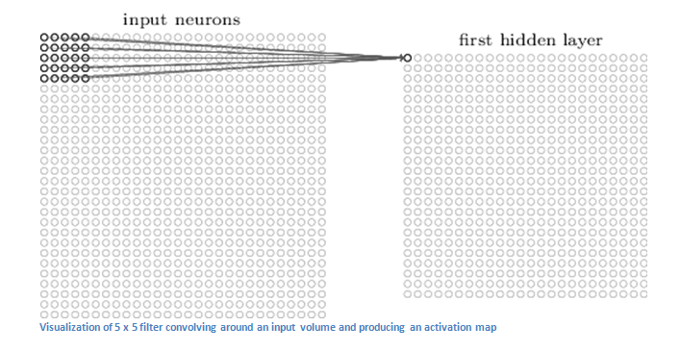
CNN (contd.)
Action Recognition in Video Sequences using Deep Bi-Directional LSTM With CNN Features
Courtesy : https://adeshpande3.github.io/A-Beginner%27s-Guide-To-Understanding-Convolutional-Neural-Networks/

Slide 11
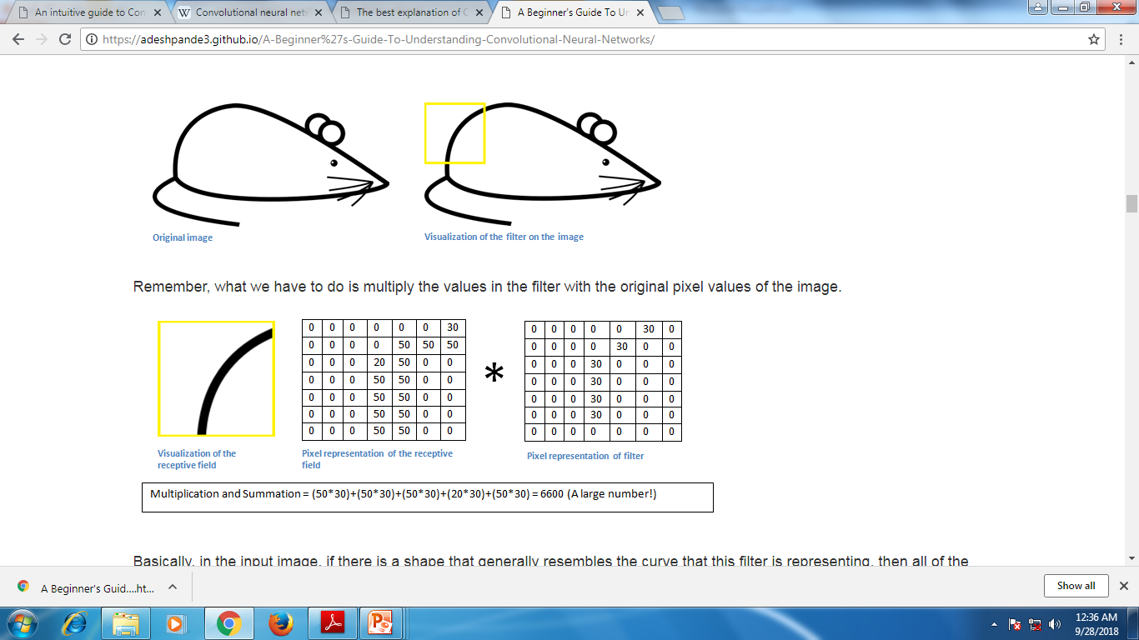
CNN (contd.)
Action Recognition in Video Sequences using Deep Bi-Directional LSTM With CNN Features
Courtesy : https://adeshpande3.github.io/A-Beginner%27s-Guide-To-Understanding-Convolutional-Neural-Networks/

Slide 12
CNN (contd.)
Action Recognition in Video Sequences using Deep Bi-Directional LSTM With CNN Features
Fully connected layer :
Output : N dimensional vector.
Represents probability.
Pooling layer
Reduce spatial size.
max pooling.

Slide 13
CNN (contd.)
Action Recognition in Video Sequences using Deep Bi-Directional LSTM With CNN Features
Training is expensive
large image set.
High processing power.
Solution : pre-trained model.
AlexNet for feature Extraction.
Trained on ImageNet Dataset.

Slide 14
AlexNet
Action Recognition in Video Sequences using Deep Bi-Directional LSTM With CNN Features
Proposed by A. Krizhevsky, I. Sutskever, and G. E. Hinton.
1000 different classes.
Input : 256*256 image.
Output : vector of 1000 numbers.
5 convolutional ,3 fully connected, 3 pooling layers.

Slide 15
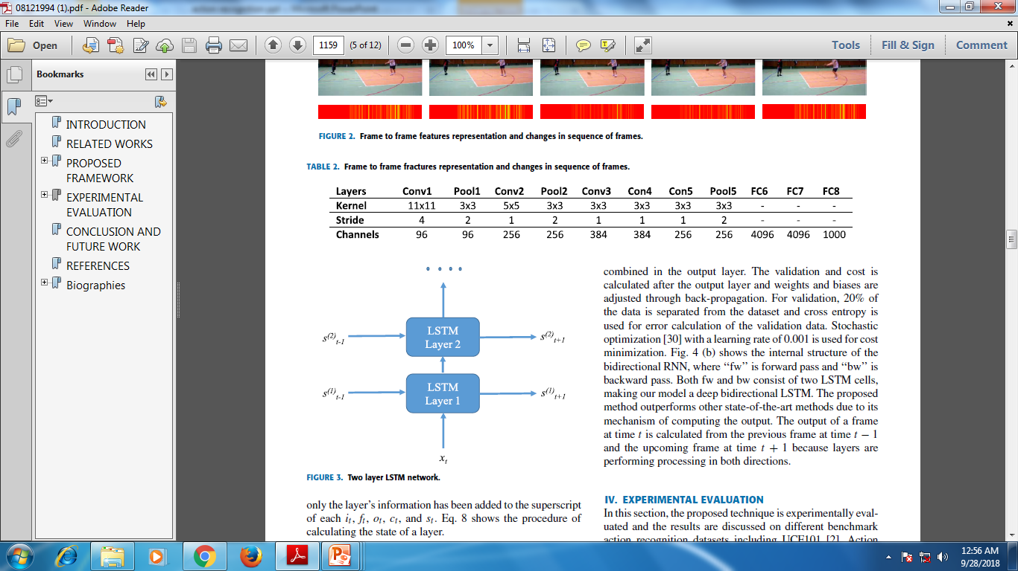
AlexNet (contd.)
Action Recognition in Video Sequences using Deep Bi-Directional LSTM With CNN Features
Courtesy : ieeexplore.ieee.org/document/8121994

Slide 16
2. Sequential learning
Action Recognition in Video Sequences using Deep Bi-Directional LSTM With CNN Features
Recurrent Neural Network(RNN) .
Vanishing Gradient Problem under long term sequences.
Exploding Gradient Problem.
Long Short Term Memory(LSTM).

Slide 17
LSTM
Action Recognition in Video Sequences using Deep Bi-Directional LSTM With CNN Features
Input, output and forget gate.
Sigmoid function.
Forget gate for long term sequencing.

Slide 18
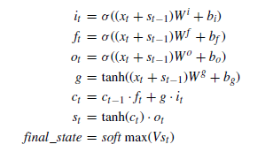
LSTM(contd.)
Action Recognition in Video Sequences using Deep Bi-Directional LSTM With CNN Features
Courtesy : ieeexplore.ieee.org/document/8121994

Slide 19
Multi Layer LSTM
Action Recognition in Video Sequences using Deep Bi-Directional LSTM With CNN Features
Large data with Complex sequence pattern
Solution : stacking multiple LSTM cells.
Performance boosted.
hidden state of previous.

Slide 20
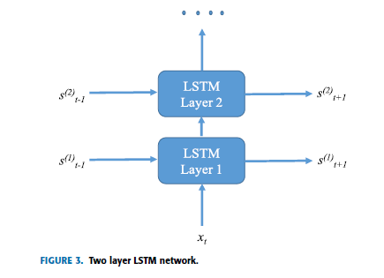
Multi Layer LSTM(contd.)
Action Recognition in Video Sequences using Deep Bi-Directional LSTM With CNN Features
Courtesy : ieeexplore.ieee.org/document/8121994

Slide 21
Deep Bidirectional LSTM
Action Recognition in Video Sequences using Deep Bi-Directional LSTM With CNN Features
Two RNNs stacked
Combined output on hidden state.
Two LSTM each ,on both forward and backward pass.
Back propagation.

Slide 22
Experimental Evaluation
Action Recognition in Video Sequences using Deep Bi-Directional LSTM With CNN Features
3 benchmarks:
UCF101 : 101 action categories.
HMDB51 : 51 action related classes.
YouTube ACTIONS : 11 sports action categories.

Slide 23
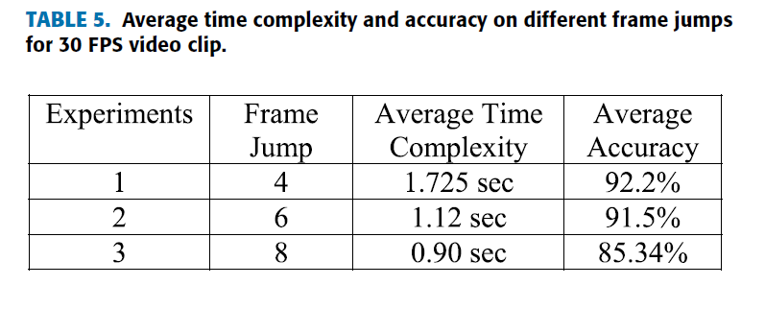
Experimental Evaluation (contd.)
Action Recognition in Video Sequences using Deep Bi-Directional LSTM With CNN Features
Courtesy : ieeexplore.ieee.org/document/8121994

Slide 24
Experimental Evaluation (contd.)
Action Recognition in Video Sequences using Deep Bi-Directional LSTM With CNN Features
20% image testing.
Incorrect predictions due to similarity in visual content.
Hence suitable candidate.

Slide 25
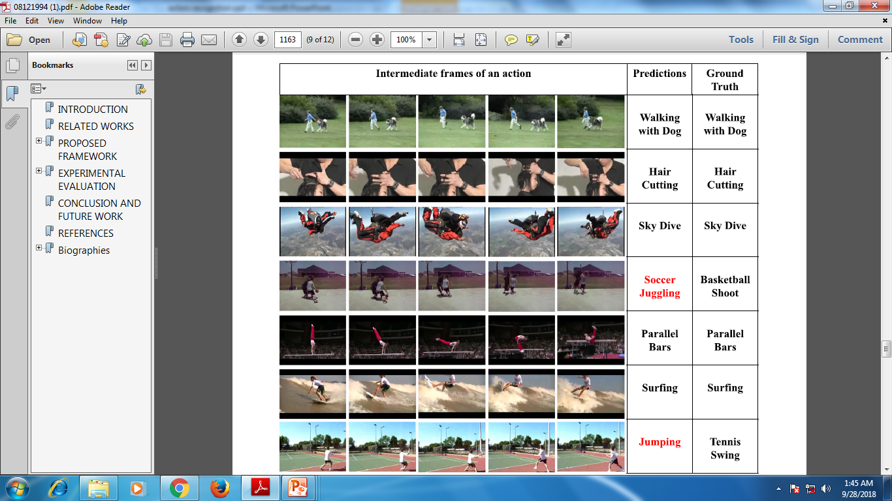
Experimental Evaluation (contd.)
Action Recognition in Video Sequences using Deep Bi-Directional LSTM With CNN Features
Courtesy : ieeexplore.ieee.org/document/8121994

Slide 26
Conclusion
Action Recognition in Video Sequences using Deep Bi-Directional LSTM With CNN Features
CNN and DB-LSTM.
Output of small chunks combined.
Successful Experimental result.
Crowded behavior.

Slide 27
References
Action Recognition in Video Sequences using Deep Bi-Directional LSTM With CNN Features
A. Krizhevsky, I. Sutskever, and G. E. Hinton, ``ImageNet classification with deep convolutional neural networks''.
K. Soomro, A. R. Zamir, and M. Shah. (2012). ``UCF101: A dataset of 101 human actions classes from videos in the wild.'‘
A. S. Razavian, H. Azizpour, J. Sullivan, and S. Carlsson, ``CNN features off-the-shelf: An astounding baseline for recognition”.
S. Hochreiter and J. Schmidhuber, ``Long short-term memory''

Slide 28
References
Action Recognition in Video Sequences using Deep Bi-Directional LSTM With CNN Features
Y. Liu, L. Nie, L. Han, L. Zhang, and D. S. Rosenblum, ``Action2Activity: Recognizing complex activities from sensor data”
L. Liu, L. Cheng, Y. Liu, Y. Jia, and D. S. Rosenblum, ``Recognizing complex activities by a probabilistic interval-based model''
I. Kaysi, B. Alshalalfah, A. Shalaby, A. Sayegh, M. Sayour, and A. Gutub, `Users' evaluation of rail systems in mass events: Case study in Mecca, Saudi Arabia,''

Slide 29
THANK YOU
Action Recognition in Video Sequences using Deep Bi-Directional LSTM With CNN Features

